Slide 1
Salmon and the Snake River Dams
Todd Myers Washington Policy Center

Slide 2
What is our priority?
Salmon recovery in the region should be our priority
“ECONW was not tasked with ranking the cost-effectiveness of every potential protection and recovery measure in all the salmon ecosystems in the Pacific basin. No doubt other measures in other locations might provide more bang for the buck.”

Slide 3
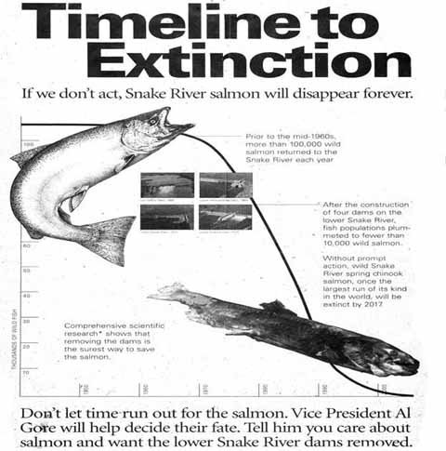
“Without prompt action, wild Snake River spring Chinook salmon, once the largest run of its kinds in the world, will be extinct by 2017.”
NY Times ad, 1999

Slide 4
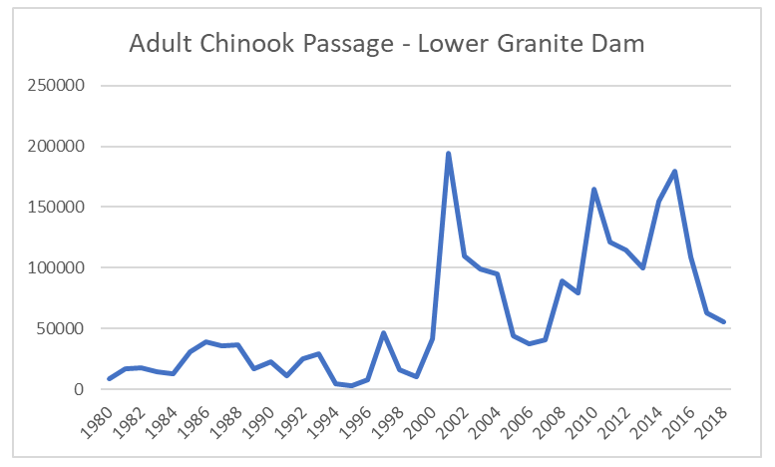
Salmon Population Increase

Slide 5
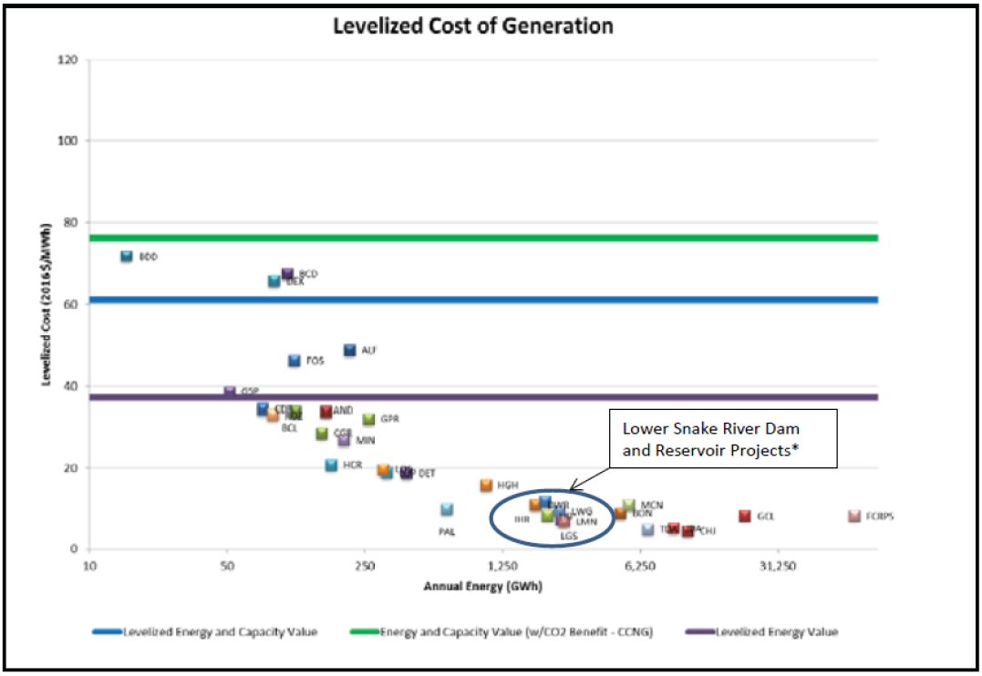
LSR Dams and Electricity
About 7% of electricity. More than all wind and solar in WA.
“If we took these dams out, we would not need to replace the electricity and we would all save money.” – Dammed to Extinction
ECONW study - $500 million a year to replace
After including salmon passage ($90 million/year), it is $23/MWh
BPA’s bonds are “high grade”

Slide 6
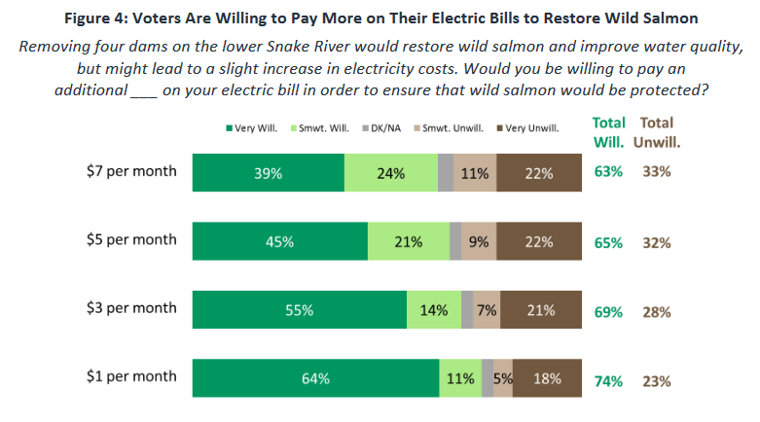
Problems With the ECONorthwest Survey
Survey done by Save Our Wild Salmon
Factual errors
“Would restore wild salmon…ensure that wild salmon would be protected.”
ECONW study admits dam removal increases recovery chance by 20%.
Survey is 400 voters in WA, but results are applied to ID, MT, OR & CA

Slide 7
Contingent Valuation Is “Misguided”
“Thus, we conclude that reliance on contingent valuation surveys in either damage assessments or in government decision making is basically misguided.” – Peter Diamond, Nobel Prize 2010
People don’t answer based on knowledge, but a surrogate of “caring for the environment.”
This is why numbers are same no matter what you ask
People don’t even know how many dams there are on the Snake River

Slide 8
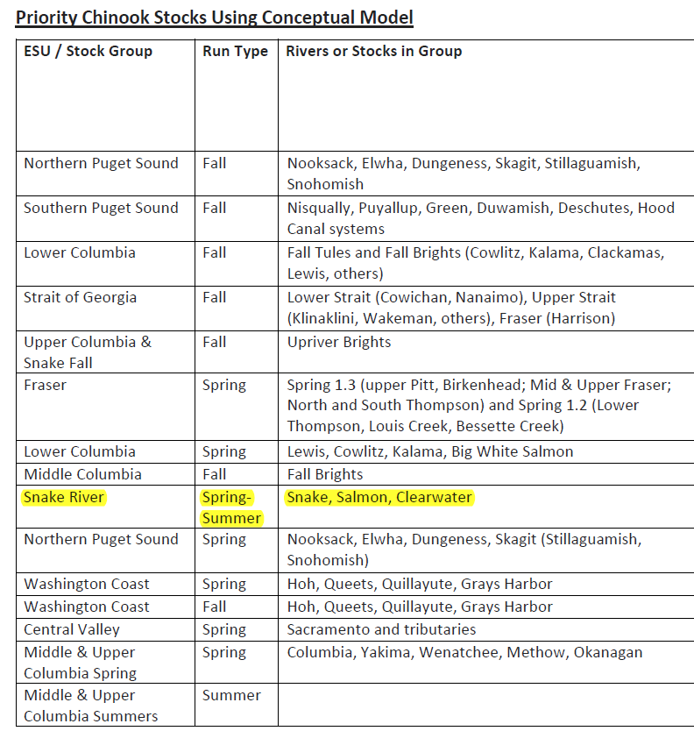
How Can We Help Orca?
“…size of the Snake River salmon stocks compared to others on the West Coast means that increases in their numbers, whether from breaching dams or otherwise, would result in only a marginal change in the total salmon available to the killer whales.”
Fund priority salmon stocks
“From each according to their ability, to each according to their need.” – Deborah Giles, UW

